Slide 1
Software Testing and Quality Assurance
Haiming Liu
liuhaiming@bjtu.edu.cn
School of Software Engineering
Beijing Jiaotong University

Slide 2

Testing the specification
What is a specification review?
A process of identifying faults in the specification of a software system.
Review should uncover both errors made in producing specification documents, and errors made earlier in the requirements engineering process.
Notes:
识别软件系统规范中的错误的过程。
审查应发现在生产规格文件时所犯的错误以及在需求工程过程中较早时所犯的错误。

Slide 3
Testing the specification
Limitations of conventional review approaches
Too much information to go through, and not enough time to do it thoroughly.
Unfamiliarity of individual reviewers with the overall goals of the design.
No single part of the specification gets a thorough and complete evaluation.
One-on-one interaction between individual reviewers and specification team is limited.
Notes:
常规审查方法的局限性

Slide 4
Testing the specification
Better method: Active specification review process
Change from “general” review to a set of more focused reviews.
Use questionnaires to engage the reviewer in using the specification.
More opportunities for one-on-one discussion between reviewer and specification team.
Notes:
更好的方法：主动规范审查过程

Slide 5
Testing the specification
An example
We have been asked to review the specification for a hospital’s order processing system.
The order processing system allows users to order items for patients, such as tests or medications.

Slide 6
Testing the specification
Active specification review process Step 1: Prepare the specification for review
Think about what criteria reviewers will use:
Well-structured
Simple
Adequate
Flexible
Practical
Easy to implement
Standardized
Notes:
主动的规范评审过程
步骤1：准备规范以进行评审

Slide 7
Testing the specification
Active specification review process Step 2: Prepare the documentation for review
Make assumptions explicit
System can record the order pertaining to a patient.
It is possible to obtain all the orders for a patient.
System can determine and change the status of an order.
The order always contains at least one item.
The status of an order is always in one of the two states i.e active or cancelled.
Incorrect Usage Assumptions
Cannot add or remove items once the order is placed.
Once an order is cancelled, the status cannot be set to active again.
An item is always added with respect to an order.
Notes:
步骤2：准备文档以供审核

Slide 8
Testing the specification
Active specification review process Step 3: Identify the specialized reviews
Focus the reviewer’s attention on specific properties of the specification (e.g., data access).
Data access sufficiency.
E.g., provides all data required by the other features of the system.
Assumption Sufficiency.
E.g., contains all of the assumptions needed to access the feature’s data.
Notes:
确定专业审查

Slide 9
Testing the specification
Active specification review process Step 4: Identify the reviewers needed
People with different perspectives and expertise are needed as reviewers
Programmers and analysts who worked on the other features of the order processing system.
Programmers and analysts familiar with hospital information systems in general.
Notes:
步骤4：确定所需的审查者

Slide 10
Testing the specification
Active specification review process Step 5: Design the questionnaires
Make reviewers take an active role
Make reviewers use the documentation
Phrase questions in an active way
E.g., “Write down the exceptions that can occur” rather than “Are exceptions defined for every program?”
Notes:
步骤5：设计问卷

Slide 11
Testing the specification
Active Specification Review Process Step 6: Conduct the review
Present an overview of the specification.
Assign reviews to the reviewers.
Reviewers complete their reviews, meeting with the specification authors as needed.
Specification authors review completed questionnaires, and meet with reviewers to resolve questions.
Specification authors produce new version of the specification.
Notes:
步骤6：进行审查

Slide 12
Testing the specification
Specification attribute checklist
Completeness
Accuracy
Precision
Consistency
Relevance
Feasibility
Code/Design-free
Testability
Notes:
产品说明书属性检查清单
完整性
准确性
精确
不含糊、清晰
关联
可行性
无代码/无设计 代码无关
可测性

Slide 13
Testing the specification
Specification terminology checklist
Always, every, all, none, never, … (absolutely sure?)
Certainly, therefore, clearly, obviously, customarily, most, … (persuasion lingo)
Some, sometimes, often, usually, ordinarily, customarily, most, … (vague)
Etc., and so forth, and so on, such as, … (not testable)
Good, fast, cheap, efficient, small, stable, … (unquantifiable)
Handled, processed, rejected, skipped, eliminated, …
If … then … (missing else)
Notes:
产品说明书用语检查清单
1、总是、每一种、所有、没有、从不。
2、当然、因此、明显、显然、必然。
3、某些、有时、常常、通常、惯常、经常、大多、几乎。
4、等等、诸如此类、依次类推、
5、良好、迅速、廉价、高效、小、稳定。
6、处理、进行、拒绝、跳过、排除。
7、如果...那么...（没有否则）。

Slide 14
Testing the specification
Conclusions
Reviewers focus on those areas they are best suited to evaluate
Time is used more wisely for all participants
More errors are likely to be found
One-on-one communication with specification authors makes it easier for people to speak up.
Few errors found does not necessarily indicate that the specification is good.
E.g., Perhaps the review process was not effective.
Notes:
审稿人专注于最适合评估的领域
与产品说明书作者的一对一交流使人们更容易说话。
几乎没有发现错误并不一定表明该规范是正确的。

Slide 15
Testing the specification
You now know …
… what a specification is
… how to review (test) a specification
… the benefits of an “active” specification review process

Slide 16
16 Weeks Plan
Week 1: The basic concepts and theories of testing
Week 2-3: Principles of Testing
Week 4: Testing the specification
Week 5-6: Black Box Testing
Week 7-9: White Box Testing
Week 10: Integration Testing and System Testing
Week 11: Usability Testing and Accessibility Testing
Week 12: Security Testing
Week 13: Mutation Testing
Week 14: Software Quality
Week 15: Review I
Week 16: Review II

Slide 17
Black-box testing
Black Box Testing is the method that does not consider the internal structure, design, and product implementation to be tested.
In other words, the tester does not know its internal functioning. The Black Box only evaluates the external behavior of the system. The inputs received by the system and the outputs or responses it produces are tested.
Notes:
黑盒测试的特点：

Slide 18
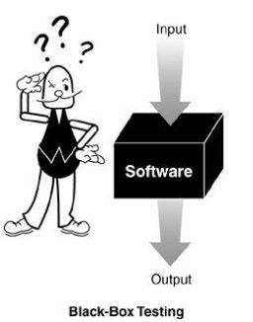
Black-box testing
Characteristics of Black-box testing:
Program is treated as a black box.
Implementation details do not matter.
Requires an end-user perspective.
Criteria are not precise.
Test planning can begin early.
Black-box testing, also called functional testing or behavioral testing
Notes:
黑盒测试的特点：

Slide 19
White-box testing
In white-box testing, the software tester has access to the program’s code and can examine it for clues to help him with his testing—he can see inside the box. Based on what he sees, the tester may determine that certain numbers are more or less likely to fail and can tailor his testing based on that information.
It is also called glass box testing or clear box testing or structural testing.

Slide 20
Static Testing is a type of a Software Testing method which is performed to check the defects in software without actually executing the code of the software application. Static testing is performed in early stage of development to avoid errors as it is easier to find sources of failures and it can be fixed easily. The errors that can’t not be found using Dynamic Testing, can be easily found by Static Testing.
Dynamic Testing is a type of Software Testing which is performed to analyze the dynamic behavior of the code. It includes the testing of the software for the input values and output values that are analyzed.

Slide 21
Black-box Testing
Obviously, we need something that defines the software--- i.e.
requirements document or specification document.
Requirements
Output
B
Running SW
Given
Input A
We must be able to specify what should be produced as output B, given input A.
Events
We do NOT need to know HOW output B is produced from input A.
Notes:
显然，我们需要一些定义软件的东西，即需求文档或规范文档。
在给定输入A的情况下，我们必须能够指定应该作为输出B生成什么。
我们不需要知道输入A是如何产生输出B的。

Slide 22
Black-box Testing
Input causing anomalous behavior
Input test data
I
System
Output which reveal the presence of defects
Output test results
O

Slide 23
Black-box Testing
Test Data and Test Cases
Test data: Inputs which have been devised to test the system.
Test cases: Inputs to test the system and the predicted outputs from these inputs if the system operates according to its specification.
Notes:
测试数据
测试用例

Slide 24
Black-box Testing
Test-to-pass and Test-to-fail
Test-to-pass:
assures that the software minimally works,
does not push the capabilities of the software,
applies simple and straightforward test cases,
does not try to “break” the program.
Test-to-fail:
designing and running test cases with the sole purpose of breaking the software.
strategically chosen test cases to probe for common weaknesses in the software.
Notes:
通过性测试和失效性测试

Slide 25
Black-box Testing
Obviously, we need something that defines the software--- i.e.
requirements document or specification document.
We must be able to specify what should be produced as output B, given input A.
We do NOT need to know HOW output B is produced from input A.
Although we can’t look at code, we may ask the programmers questions about numeric limits, internal quirks of the software etc. (More on this shortly.)

Slide 26
Random Testing
Equivalence Partitioning
Boundary Value Analysis

Slide 27
Random Testing(RT)
Test cases are generated purely at random
Input domain must be known
Pick random points within input domain
Automation
int Add(const int &a, const int &b)
{
return a+b;
}
16 bit
Notes:
测试用例是完全随机生成的

Slide 28
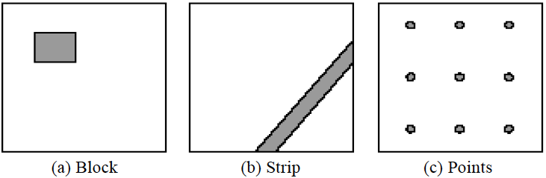
Random Testing
Typical patterns of failure-causing regions
A passed test, nearby tests may be passed
A failed test, nearby tests may be failed
So, select test cases far away from others …
Notes:
已经有研究人员发现，能够导致软件出错的分布一般分为：
例如矩形状分布（block），条带状分布(strip)和散点状分布(points)

Slide 29
Adaptive Random Testing(ART)
Random Testing

Slide 30
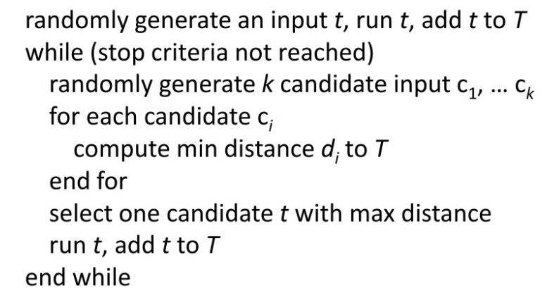
FSCS-ART algorithm
Problem in ART
Distance
Sampling
Notes:
​固定候选集的自适应随机测试算法（FSCS-ART algorithm）：

Slide 31
Anti-Random Testing
Hamming Distance
x ⊕ y= z
10101 ⊕ 00110 = ?
10101 ⊕ 00110 = 3
10101
00110
Notes:
​逆随机测试

Slide 32
Define equivalence partitions - or classes
Equivalence partitioning helps us cut down the number of test cases without adding a great deal of risk.
Normally we look at two areas for testing:
- Data
- Logic flow
There are many guidelines for picking equivalence partitions.
Note: These are guidelines, not hard and fast rules.
Notes:
等价划分可以帮助我们减少测试用例的数量，而不会增加很多风险。等价类划分是指分步骤地把海量或是无限的测试用例缩减的很少，但是过程同样有效。

Slide 33
Data Testing GUIDELINES FOR CHOOSING EQUIVALENCE CLASSES
Identify boundary conditions - data that is at the edge of the planned operational limits of the software.
For the boundaries, partition input into
- Valid data inside the boundary.
- Data just on the boundary (which may be valid or invalid).
- Invalid data just outside the boundary limits.
Boundary conditions should be identified in the requirements or the specifications.
Notes:
对于边界，将输入划分为
-边界内的有效数据。
-边界上的数据（可能有效或无效）。
-超出边界限制的无效数据。

Slide 34
Equivalence Partitioning
Idea is to partition the input space into a number of equivalence classes such that one could expect, based on the specification, that every element of a given class would be ‘‘handled’’ (i.e., mapped to
an output) in the same manner
(either correctly or incorrectly),
thus reducing the total number of test cases that must be developed.
Two types of classes are identified:
valid (corresponding to inputs deemed valid from the specification)
invalid (corresponding to inputs deemed erroneous from the specification)
Notes:
等价类划分其思想是将输入空间根据规范划分为若干等价类，这样可以期望给定类的每个元素都以相同的方式“处理”（即映射到输出）（正确或错误），从而减少必须开发的测试用例总数。
等价类是指某个输入域的子集合。

Slide 35
Equivalence Partitioning
Divide all possible inputs into classes (partitions) such that : There is a finite number of input equivalence classes
You may reasonably assume that
The program behaves analogously for inputs in the same class
One test with a representative value from a class is sufficient
If the representative detects a fault, then other class members would detect the same fault
i₁
i₄
i₂
i₃
all inputs
Notes:
将所有可能的输入划分为类（分区），以便：有有限个输入等价类

Slide 36
Equivalence Classes
Valid data
User supplied commands.
Responses to system prompts.
File names.
Computational data:
Physical parameters,
Bounding values,
Initiation values.
Output data formatting commands.
Responses to error messages.
Graphical data.
Invalid data
Data outside bounds of the program.
Physically impossible data.
Proper value supplied in wrong place.
Notes:
有效数据
无效数据

Slide 37
Equivalence Classes Strategy
Identify input equivalence classes
Based on conditions on inputs/outputs in specification/description: Both valid and invalid input equivalence classes
Based on heuristics and experience :
“input x in [1..10]”
→ classes : x < 1, 1 ≤ x ≤ 10, x > 10
“enumeration A, B, C“
→ classes : A, B, C, not{A,B,C,}
"input integer
→ classes : n not an integer, n < min, min ≤ n < 0, 0 ≤ n ≤ max, n > max
Notes:
识别输入等价类

Slide 38
Equivalence Partitioning Example 1
Partition system inputs into groups (partitions) that should cause
equivalent behaviour, include both valid and invalid inputs.
If input is a 5-digit integer between 10,000 and 99,999,
Equivalence partitions are:
< 10,000 10,000 - 99,999 > 99,999
Notes:
将系统输入划分到组（分区）中，这些组（分区）应引起等效行为，包括有效和无效输入。

Slide 39
Equivalence Partitioning Example 2
Identify (multiple sets of disjoint) equivalence classes for the following program specification fragment.
Individual Income Tax Specification:
If gross pay is no more than ￥36,000, the tax is 3%.
If gross pay is more than ￥36,000, but no more than ￥144,000, the tax is 10%.
If gross pay is more than ￥ 144,000, but no more than ￥300,000, the tax is 20%.
If gross pay is more than ￥ 300,000, but no more than ￥420,000, the tax is 25%.
Notes:
为以下程序规范片段标识（多组不相交的）等价类。
个税：

Slide 40
Equivalence Partitioning
1. If input is a range, one valid and two invalid equivalence classes:
less than range
in range
greater than range
2. If input is a specific value, one valid and two invalid equivalence classes:
less than value
value
greater than value
3. If input is a set of related values, one valid and one invalid class:
not member of set
member of set
4. If input is Boolean, one valid and one invalid class:
nonBoolean
Boolean

Slide 41
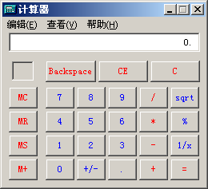
Equivalence Partitioning Example 3
Test for addition operation of MS calculator.

Slide 42
Equivalence Partitioning
Test for Personal name（上户口）

Slide 43

Equivalence Partitioning
Test for ID number（身份证）

Slide 44
To be continued… See you next week

